Slide 1



Applied Data Analysis (CS401)
Lecture 9
Learning from data: Unsupervised learning
15 Nov 2023
Robert West
Notes:
2020: timing very good: 92 min (10-min break, ~5 min for course eval)
2021: idem: 90 min (11-min break; ~4 min for course eval)
2023: 90 min (14-min break)

Slide 2
Announcements
Project milestone P2 due on Fri 17 Nov 23:59 (see Ed)
Reminder: we won’t answer questions asked in the final 24 hours before the deadline
Homework H2 to be released on Fri 17 Nov
Due two weeks later, on Fri 1 Dec
Friday’s lab session:
Quiz 8
Exercises on unsupervised learning

Slide 3
Give us feedback on this lecture here: https://go.epfl.ch/ada2023-lec9-feedback
What did you (not) like about this lecture?
What was (not) well explained?
On what would you like more (fewer) details?
…
Notes:
As you know, feedback is very important to us
…
In this spirit: course eval (p.t.o.)

Slide 4
Machine learning
Supervised: We are given input/output pairs (X, y) (a.k.a. “samples”) that are related via a function y = f(X). We would like to “learn” f, and evaluate it on new data.
Discrete y (class labels): “classification”
Continuous y: “regression” (e.g., linear regression)
Unsupervised: Given only samples X of the data, we compute a function f such that y = f(X) is a “simpler” representation.
Discrete y (cluster labels): “clustering”
Continuous y: “dimensionality reduction” (e.g., matrix factorization, unsupervised neural networks)
Notes:
“Continuous y”: “simpler” = smaller dimensionality than X
This lecture: clustering
Will see dim reduction in next 2 lectures (handling text)

Slide 5
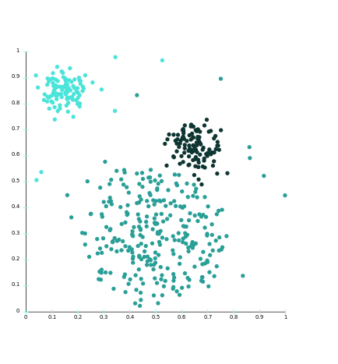
The clustering problem
Given a set of points, with a notion of distance between points, group the points into some number of clusters, such that
members of a cluster are close (i.e., similar) to each other
members of different clusters are far apart from each other
Usually:
Points live in a high-dimensional space
Similarity is defined via a distance measure
Euclidean, cosine, Jaccard, edit distance, … (cf. lecture 7)

Slide 6
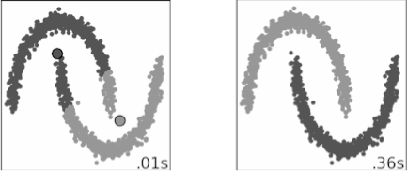
Characteristics of clustering methods
Quantitative: scalability (many samples), dimensionality (many features)
Qualitative: types of features (numerical, categorical, etc.), type of shapes (polyhedra, hyperplanes, manifolds, etc.)
Notes:
Left: method that can only find polyhedral (i.e. convex) clusters was applied to dataset containing non-convex clusters
We’ll see methods for both pictures today (k-means and DBSCAN)

Slide 7
Characteristics of clustering methods
Robustness: sensitivity to noise and outliers, sensitivity to the processing order
User interaction: incorporation of user constraints (e.g., number of clusters, max size of clusters), interpretability and usability

Slide 8
Example: clusters & outliers
x
xx x
x x
x x x
x
x x x
x
x
x x
x x x x
x x x x
x x x
x x
x x
x x x x
x x x x
x x x
x x
x x
x x x x
x x x
x
x x
x x x x
x x x
x
x
Outlier
Cluster
Notes:
Just to clarify some terminology

Slide 9


A typical clustering example
Input
Output
Note: Above is 2D; real scenarios often much more high-dimensional, e.g., 10,000-dimensional for 100x100 images.
Notes:
Think for yourselves: “How many clusters?”

Slide 10
Some use cases for clustering
Data exploration (especially for high-dimensional data, where visualization fails)
Partitioning of data for more fine-grained subsequent analysis
Marketing: building personas
Supporting data labeling for supervised learning
Supporting feature discretization for supervised learning (cf. lecture 8)
Data compression (next slide)
…
Notes:
E.g., understand if there are characteristic subgroups of data; inspect representatives of each cluster
Can do separate, fine-grained analysis per cluster

Slide 11
Clustering for condensation/compression
Here we don’t require that clusters extract meaningful structure, but that they give a coarse-grained version of the data.
Notes:
Black points (cluster centers) provide a summary of the data

Slide 12
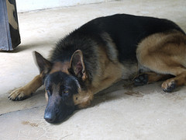

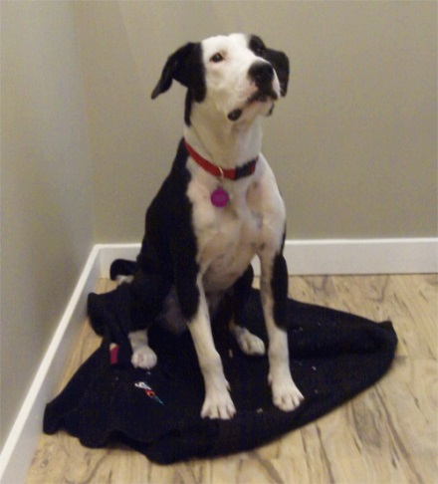
Beware of “cluster bias”!
Human beings conceptualize the world through categories represented as exemplars or prototypes
We tend to see cluster structure whether it is there or not.
Works well for dogs, but…
Notes:
Humans are “clustering machines”

Slide 13
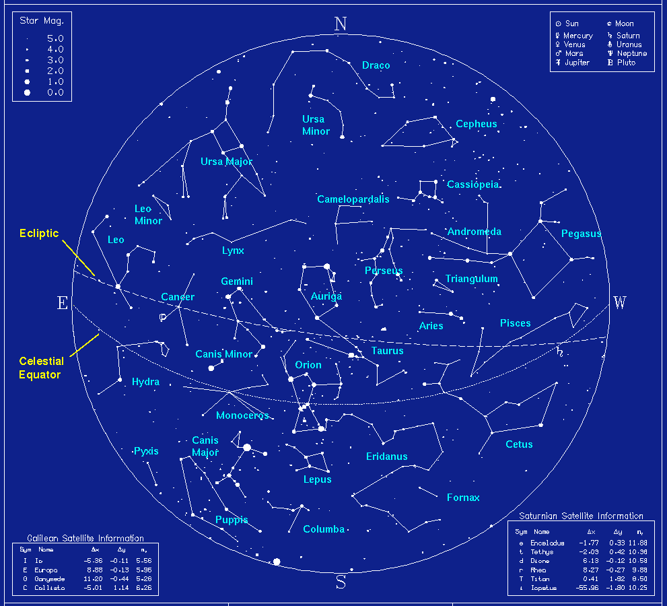
Cluster bias

Slide 14
Cluster bias
Clustering is used more than it should be, because people assume an underlying domain has discrete classes in it
Especially true for characteristics of people, e.g., Myers-Briggs personality types like “ENTP”.
In reality the underlying data is often continuous.
In such cases, continuous models (e.g., matrix factorization, “soft” clustering) tend to do better (cf. next slide)
Notes:
extraversion, intuition, thinking, perception
4 binary vars ⇒ 16 personality types

Slide 15
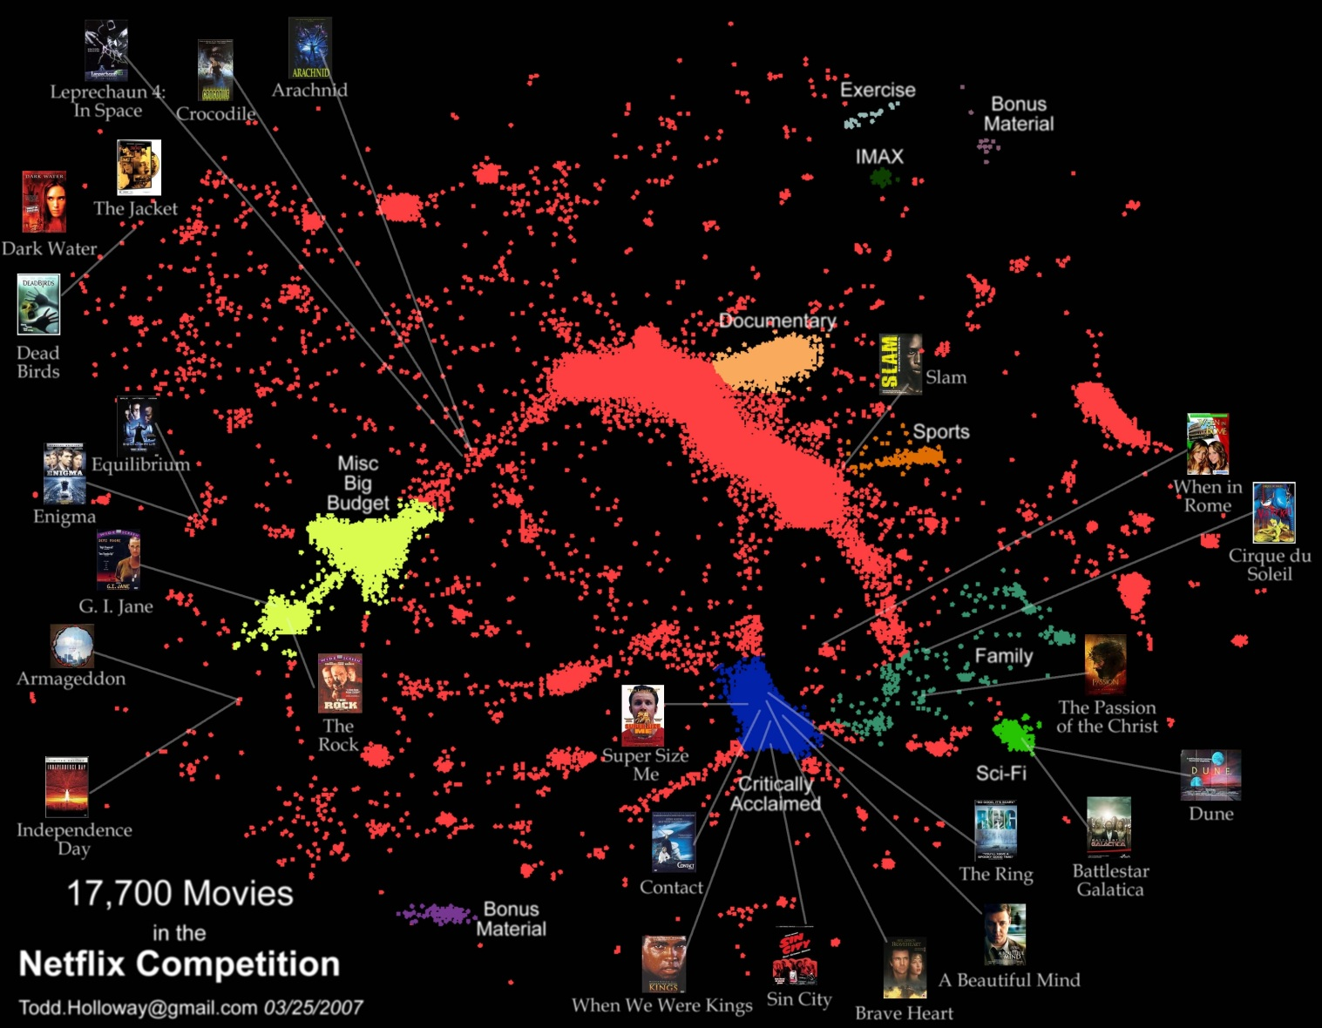
Netflix
Central portion: more of a continuum than discrete clusters
Other methods (e.g., dimensionality reduction) may be more appropriate than discrete clustering models
Notes:
Looks like Lake Geneva
But is a 2D representation of movies (original input features: who watched them; closer in 2D if watched by more similar sets of people)
There are some clear clusters on the fringe, but most data lumped together in “Lake Geneva”
…
(will cover matrix factorization in next two weeks)

Slide 16
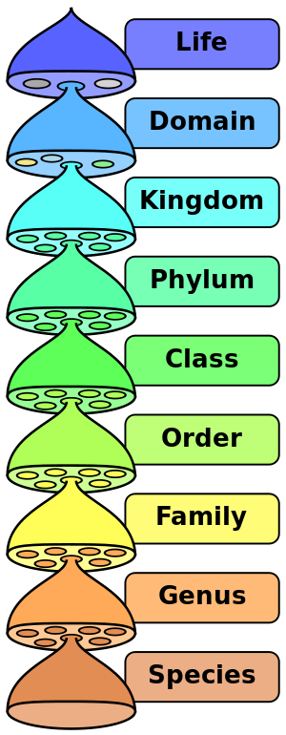
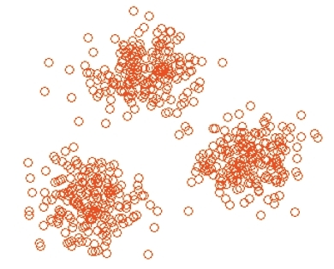
Terminology
Hierarchical clustering: clusters form a tree-shaped hierarchy. Can be computed bottom-up or top-down.
Flat clustering: no inter-cluster structure
Hard clustering: items assigned to a unique cluster
Soft clustering: cluster membership is a probability distribution over all clusters
Notes:
After these high-level remarks, let’s dive in!
Hierarchical: taxonomy in bio, tree of life
...

Slide 17
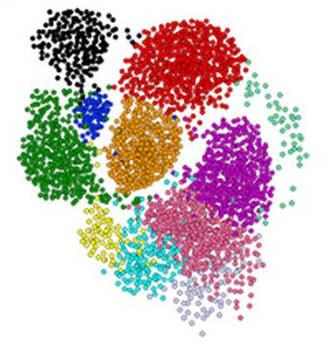
Clustering is a hard problem!

Slide 18
Why is it hard?
Clustering in 2 dimensions looks easy
Clustering small amounts of data looks easy
And in these special cases, it actually is often easy, but...
… many applications involve not 2, but hundreds or thousands of dimensions (and large amounts of data)
High-dimensional spaces are different (“curse of dimensionality”): volume grows exponentially w/ #dims; space is sparsely populated; clusters become less tight

Slide 19
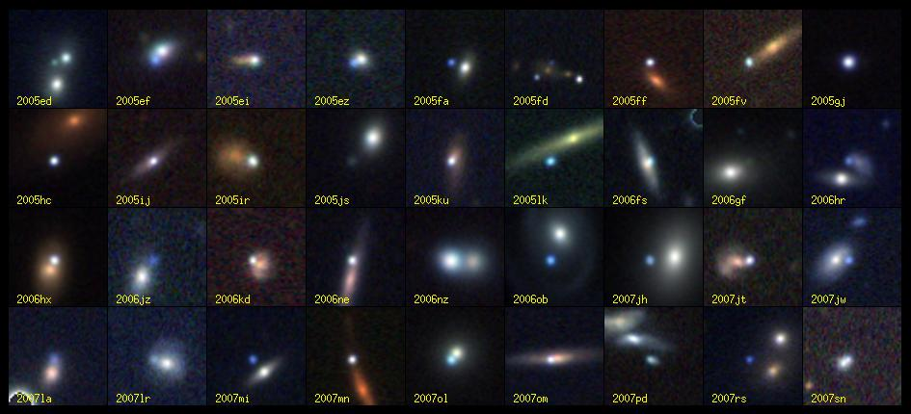
Clustering problem: galaxies
A catalog of 2 billion “sky objects” represents objects by their radiation in 7 dimensions (frequency bands)
Problem: Cluster into similar objects, e.g., galaxies, nearby stars, quasars, etc.
Sloan Digital Sky Survey [link]
Notes:
Now some concrete example applications of clustering

Slide 20
Clustering problem: movies
Intuitively: Movies divide into categories/genres, and customers prefer a few categories
But what are categories really?
→ take a data-driven approach!
Represent a movie by a set of customers who watched it (“collaborative filtering”)
Idea: Similar movies have similar sets of customers, and vice-versa
Notes:
Cf. “Lake Geneva” of Netflix movies

Slide 21
Clustering problem: movies
Space of all movies:
Think of a space with one dimension for each customer
Values in a dimension may be 0 or 1 only
A movie is a point in this space (x₁, x₂,…, x_{n}), where x_{i} = 1 iff the i-th customer watched the movie
For Amazon/Netflix, the dimensionality is in the millions
Task: Find clusters of similar movies

Slide 22
Clustering problem: documents
Finding topics:
Represent a document by a vector (x₁, x₂,…, x_{n}), where x_{i} = 1 iff the i-th word appears in the document (in any position)
Idea: Documents with similar sets of words are about same topic

Slide 23
Cosine, Jaccard, Euclidean distances
In both examples (movies, documents) we have a choice when we thinking of data points as sets of features (users, words):
Sets as vectors:
Measure similarity via Euclidean distance
Measure similarity via cosine distance
Sets as sets:
Measure similarity via Jaccard index

Slide 24
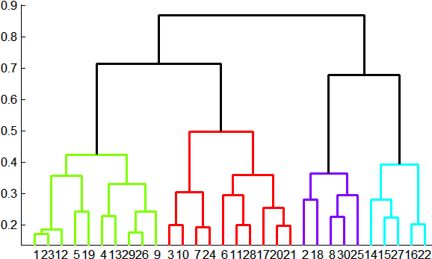
Overview: Methods of clustering
Hierarchical methods:
Agglomerative (bottom-up):
Initially, each point is a cluster
Repeatedly combine the two “nearest” clusters into one
Divisive (top-down):
Start with one cluster and recursively split it
Flat methods (a.k.a. point-assignment methods):
Maintain a set of clusters
Assign points to “nearest” cluster; recompute clusters; repeat
Notes:
A hierarchical clustering of clustering methods!

Slide 25
Agglomerative hierarchical clustering
Key operation: Repeatedly combine two nearest clusters
Three important questions:
(1) How to represent a cluster of more than one point?
(2) How to determine the “nearness” of clusters?
(3) When to stop combining clusters?
Notes:
Start w/ hierarchical clustering; focus on agglomerative (divisive is similar, but in “reverse mode”)

Slide 26
Agglomerative hierarchical clustering
Key operation: Repeatedly combine two nearest clusters
(1) How to represent a cluster of many points?
Euclidean case: represent a cluster via its centroid = average of points in cluster
What about non-Euclidean case?
(2) How to determine “nearness” of clusters?
Euclidean case: distance between clusters = distance between centroids
What about non-Euclidean case?
Notes:
Non-Euclidean: in 2 slides

Slide 27
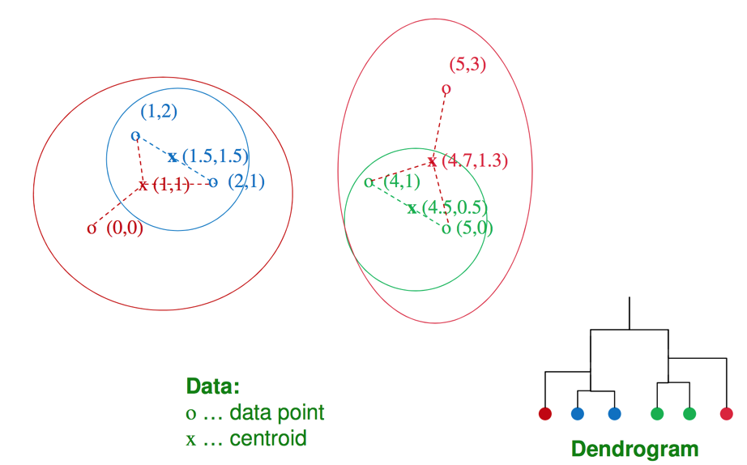
Example: Hierarchical clustering
Notes:
(sorry for RGB – not colorblind-friendly)
…
Dendrogram lets you fully reconstruct sequence of groupings

Slide 28
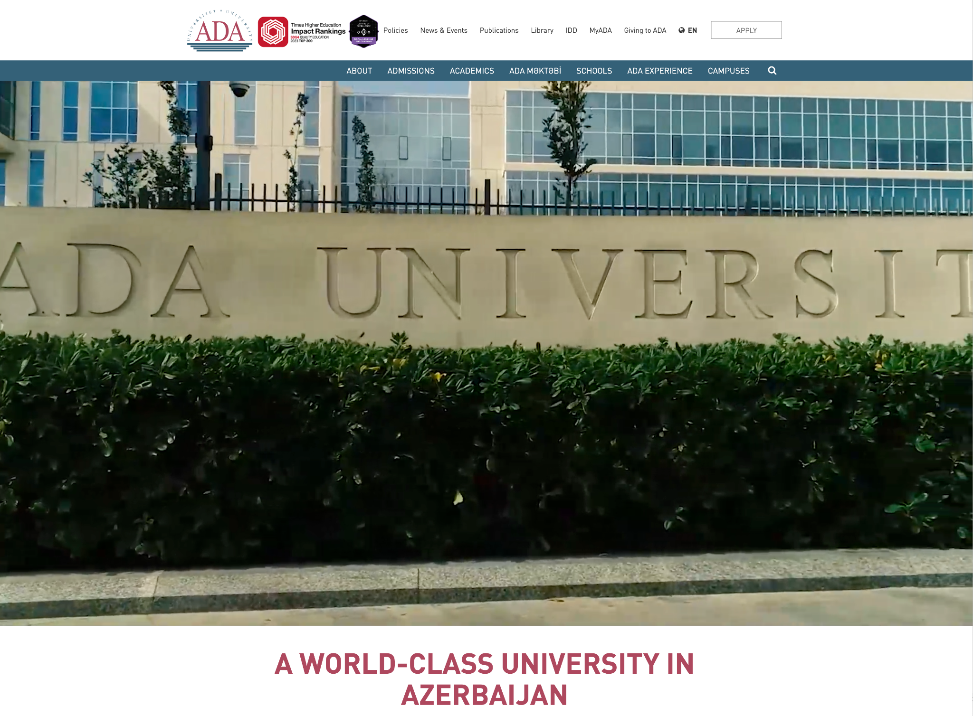

Commercial break
ada.edu.az
Data science from A to Z

Slide 29
Non-Euclidean case: clustroids
(1) How to represent a cluster of many points? clustroid = actual data point that is “closest” to the other points
Possible meanings of “closest”:
Smallest average distance to other points (a.k.a. medoid)
Smallest sum of squares of distances to other points
Smallest maximum distance to other points
Data point
Centroid
Centroid is the avg. of all data points in the cluster. This means centroid is an “artificial” point.
Clustroid is an existing data point that is “closest” to all other points in the cluster.
X
Clustroid
Cluster of 3 data points
Notes:
E.g., edit distance of strings: average/centroid not defined
Advantages even for Euclidean case: clustroid is real point: interpretable

Slide 30
Non-Euclidean case: cluster “nearness”
(2) How do you determine the “nearness” of clusters?
Approach 1: Intercluster distance = minimum of the distances between any two points, one from each cluster; or average of distances; or distance between clustroids; etc.
Approach 2: Pick a notion of “cohesion” (“tightness”) of a cluster Then: nearness of clusters = cohesion of their union
Notes:
…
Difference w/ intercluster-distance methods: don’t care about cluster membership after taking union

Slide 31
Cohesion
Approach 2.1: Use the diameter of the merged cluster = maximum distance between points in the merged cluster
Approach 2.2: Use the average distance between points in the merged cluster

Slide 32

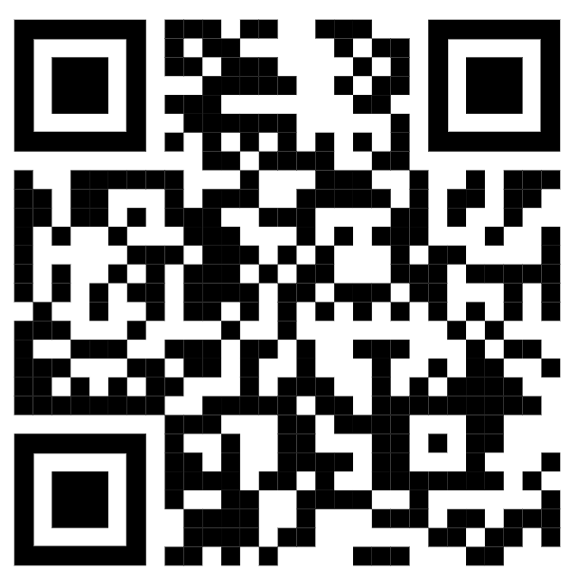
How many branching points are there in a dendrogram for a dataset with N data points?
POLLING TIME
Scan QR code or go to https://web.speakup.info/room/join/66626
Notes:
Let’s think about the complexity of hier clust methods. For this purpose, I’d like you to think about this Q:
How many branching points are there in a dendrogram for a dataset with N data points?
(A) log(N)
(B) N-1
(C) N/2
(D) 2^N
(E) sqrt(N)

Slide 33
Implementation
Naïve implementation of hierarchical clustering:
At each step, compute pairwise distances between all pairs of clusters, then merge
O(N³), where N is the number of data points
Careful implementation using priority queue can reduce time to O(N² log N)
Still too expensive for really big datasets
Notes:
N clusters in beginning (one per point) → N^2 pairs, N-1 aggregation steps (see previous slide*) → O(N^3) overall
PQ implementation: food for thought
https://www.cs.utah.edu/~jeffp/teaching/cs5140-S17/cs5140/L8-hierarch.pdf
* In every merge step, you eliminate one cluster. Since there are N cluster in the beginning, you need N-1 merge steps until everything is in one big cluster.

Slide 34

Overview: Methods of clustering
Hierarchical methods:
Agglomerative (bottom-up):
Initially, each point is a cluster
Repeatedly combine the two “nearest” clusters into one
Divisive (top-down):
Start with one cluster and recursively split it
Flat methods (a.k.a. point-assignment methods):
Maintain a set of clusters
Assign points to “nearest” cluster; recompute clusters; repeat
NEXT

Slide 35
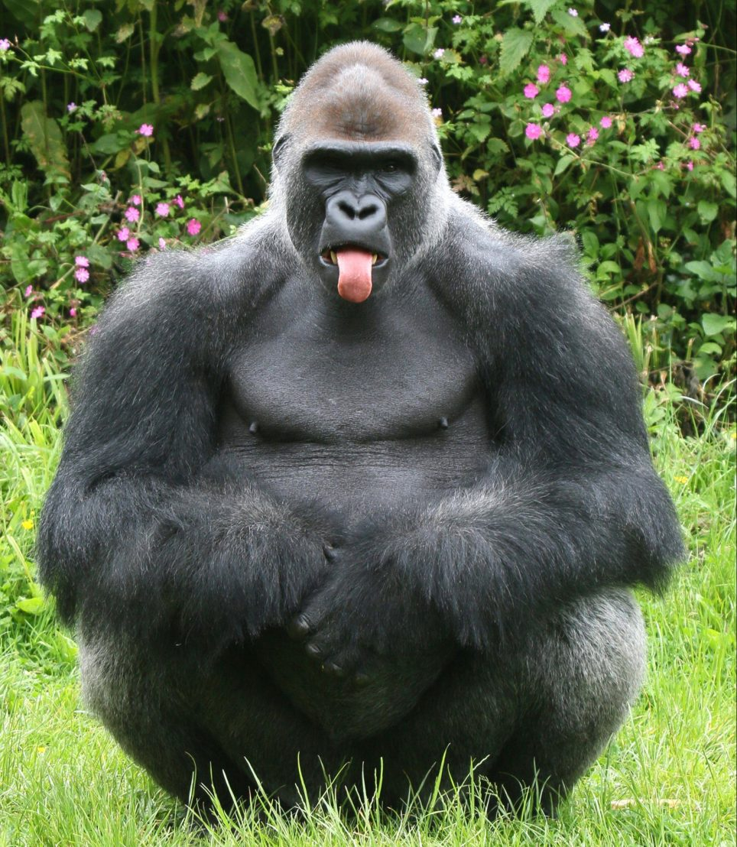
K-means
The gorilla among the point-assignment clustering algorithms

Slide 36
K-means clustering
Goal: assign each data point to one of k clusters such that the total distance of points to their centroids is minimized
Solved by a simple greedy algorithm (Lloyd’s algorithm): Locally minimize the “distance” (usually squared Euclidean distance) from data points to their respective centroids:
Find the closest cluster centroid for each data point, and assign the point to that cluster.
Recompute the cluster centroid (the mean of data points in the cluster) for each cluster.

Slide 37
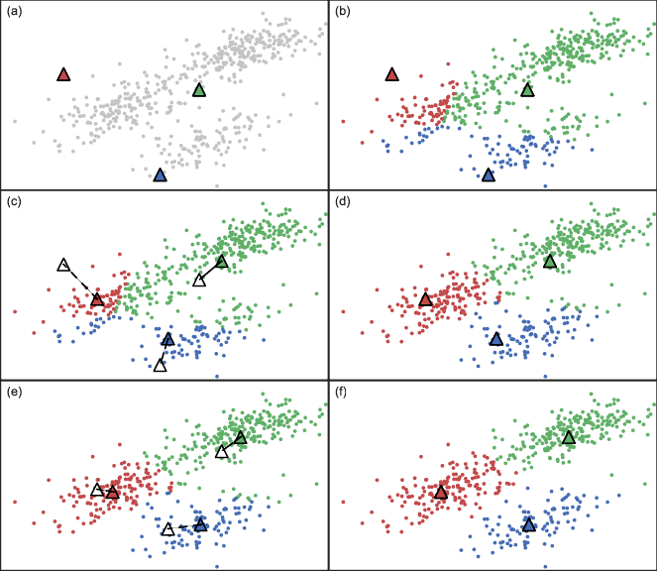
K-means clustering
Notes:
(Apologies to colorblind students)
Initial clusters sampled from data (more on this in 2 slides)
(Source: https://www.researchgate.net/figure/K-means-example-in-2D-space-a-Cluster-centroids-are-initialized-at-random-positions_fig1_318042263)

Slide 38
K-means clustering
How long to iterate?
For fixed number of iterations
or until no change in assignments (guaranteed to happen)
or until only small change in cluster “tightness” (sum of [squared] distances from points to centroids)

Slide 39
K-means initialization
We need to pick some points for the first round of the algorithm:
Random sample: Pick a random subset of k points from the dataset.
K-Means++: Iteratively construct a random sample with good spacing across the dataset.
Note: Finding an optimal k-means clustering is NP-hard. The above help avoid bad configurations.

Slide 40
K-means++ [link]
Start: Choose first cluster center at random from the data points
Iterate:
For every remaining data point x, compute the distance D(x) from x to the closest previously selected cluster center.
Choose a remaining point x randomly with probability proportional to D(x)², and make it a new cluster center.
Intuitively, this finds a sample of widely-spaced points from dense regions of the data space, avoiding “collapsing” of the clustering into a few internal centers.
Notes:
(May skip if short on time)

Slide 41
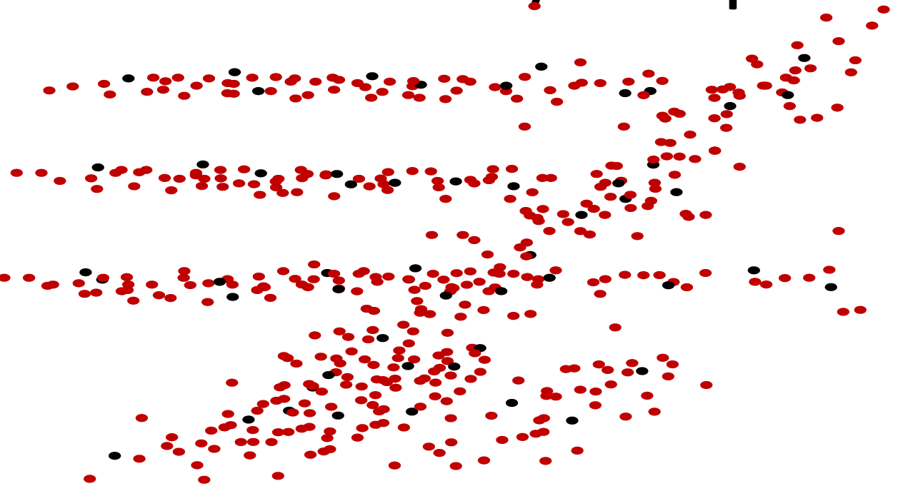
K-means properties
Greedy algorithm with random initialization – solution may be suboptimal & vary significantly with different initial points
Very simple convergence proofs
Performance is O(nk) per iteration — not bad, and can be heuristically improved n = number of points in the dataset, k = number clusters
Many variants, e.g.
Fixed-size clusters
Soft clustering
Works well for data condensation/compression
Notes:
(Performance also linear in the number of features)

Slide 42
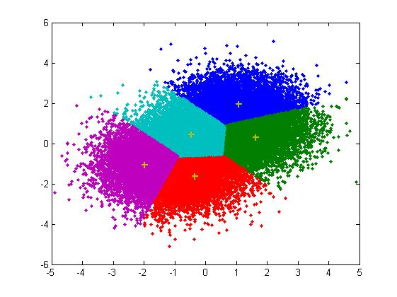
K-means drawbacks
Often terminates at a local but non-global optimum (mitigated by smart initialization such k-means++, or by re-running multiple times with different initializations)
Requires the notion of a mean
Requires specifying k (number of clusters) in advance
Doesn’t handle noisy data and outliers well
Clusters only have convex shapes
Notes:
Solutions for most of these. Convex shape hardest to overcome; need different paradigm altogether (--> DBSCAN in 2 slides)

Slide 43
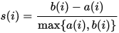
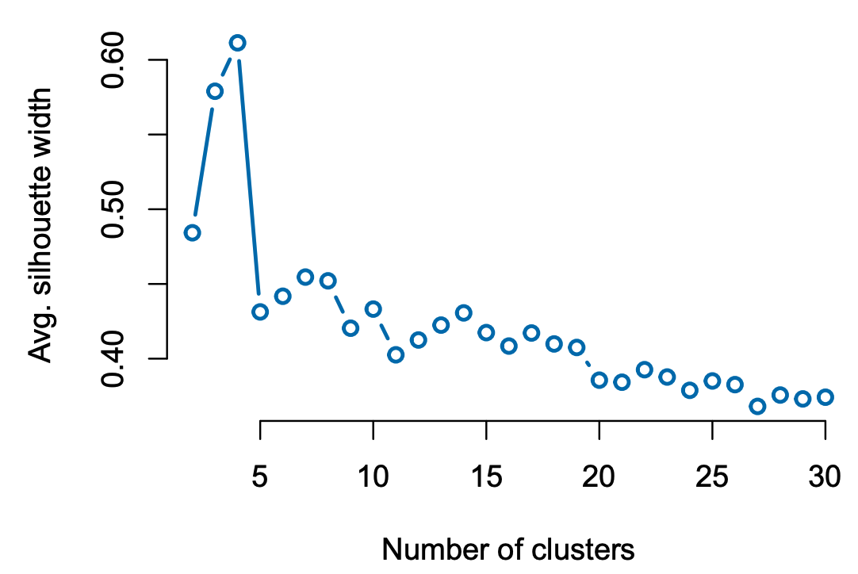
How to choose k?
For k = 1, 2, 3, …
Run k-means with k clusters
For each data point i, compute “silhouette width”
S = average of s(i) over all i
Plot S against k
Pick k for which S is greatest
b(i): avg. distance to points in closest
other cluster
a(i): avg. distance to points in own cluster
S
k
Notes:
First explain silhouette width of a data point in a given clustering; then algo
Explain “closest other cluster”:
For each other cluster C, compute avg. distance between i and points in cluster C
Closest other cluster is the cluster C for which the above is minimized
“max” to scale to [-1,1], so silhouettes for different i are comparable
s(i) between -1 and 1
negative if closer to other than to own cluster

Slide 44
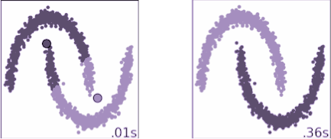
DBSCAN
“Density-based spatial clustering of applications with noise”
Motivation: centroid-based clustering methods like k-means favor clusters that are spherical, and have great difficulty with anything else
But with real data we often have:

Slide 45
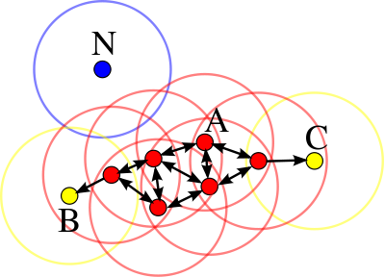
DBSCAN
DBSCAN performs density-based clustering, and follows the shape of dense neighborhoods of points.
Def.: core points have at least minPts neighbors in a sphere of diameter ε around them.
The red points here are core points with at least minPts = 3 neighbors in an ε-sphere around them.
Notes:
A lot of defs. Once we have defs, algo is a breeze

Slide 46
DBSCAN
More definitions (!):
Core points can directly reach neighbors in their ε-sphere
From non-core points, no other points can be reached
Point q is density-reachable from p if there is a series of points p = p₁, …, p_{n} = q such that p_{i+1} is directly reachable from p_{i}
All points not density-reachable from any other points are outliers/noise
Notes:
Direct reachability: arcs in example graph
So all points on the path p1,…pn must be core points, except possibly pn
Yellow = “fringe” (non-core point that are reachable from the core)
Reachability is an asymmetric notion

Slide 47
DBSCAN clusters
Even more definitions:
Points p, q are density-connected if there is a point o such that both p and q are density-reachable from o.
A cluster is a set of points that are mutually density-connected.
That is, if a point is density-reachable from a cluster point, it is part of the cluster as well.
In the above figure, red points are mutually density-reachable; B and C are density-connected; N is an outlier.
Notes:
Connectedness (unlike reachability) is a symmetric notion (in picture, make edges undirected)
B, C are density-connected, but not density-reachable

Slide 48
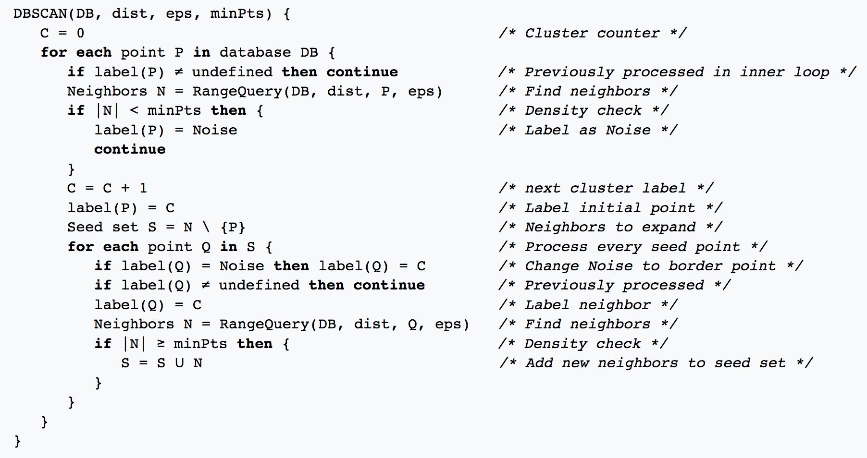
DBSCAN algorithm
Notes:
Pseudocode for your bathroom musings
Intuition much simpler:
Pick an unseen point
Grow cluster around it as widely as possible (using epsilon balls around core points)
Iterate

Slide 49

DBSCAN performance
DBSCAN uses all-pairs point distances, but using an efficient indexing structure, each RangeQuery (for finding neighbors within ε-sphere) takes only O(log n) time
The algorithm overall can be made to run in O(n log n)
Fast neighbor search becomes progressively harder (higher constants) in higher dimensions, due to the
curse of dimensionality, ahhhhh!

Slide 50
Give us feedback on this lecture here: https://go.epfl.ch/ada2023-lec9-feedback
What did you (not) like about this lecture?
What was (not) well explained?
On what would you like more (fewer) details?
…
Notes:
As you know, feedback is very important to us
In this spirit: course eval (p.t.o.)

Slide 51
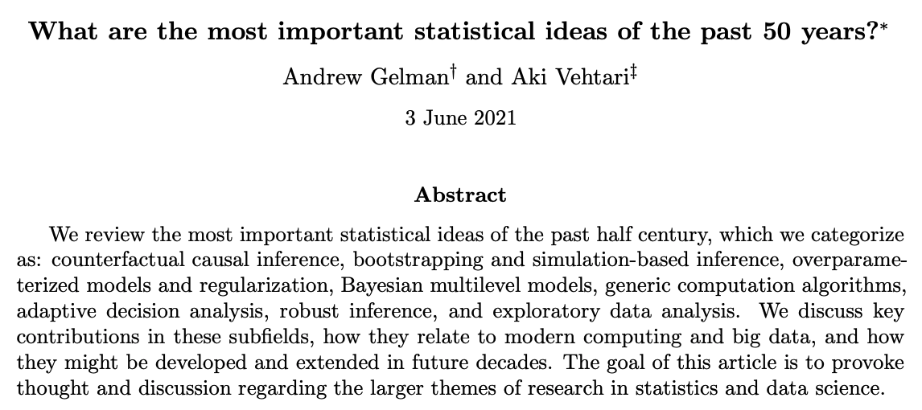
https://arxiv.org/abs/2012.00174

